Slide 1

Basic Processing Unit

Slide 2
Syllabus:
Fundamental concepts
Execution of complete instruction
Multiple bus organization

Slide 3
Fundamental Concepts
Processor fetches one instruction at a time and perform the operation specified.
Instructions are fetched from successive memory locations until a branch or a jump instruction is encountered.
Processor keeps track of the address of the memory location containing the next instruction to be fetched using Program Counter (PC).
Instruction Register (IR)

Slide 4
Executing an Instruction
Fetch the contents of the memory location pointed to by the PC. The contents of this location are loaded into the IR (fetch phase).
IR ← [[PC]]
Assuming that the memory is byte addressable, increment the contents of the PC by 4 (fetch phase).
PC ← [PC] + 4
Carry out the actions specified by the instruction in the IR (execution phase).

Slide 5
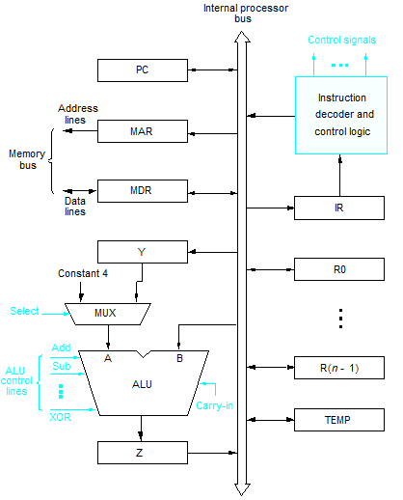
Single Bus Architecture
Fig:refer from Carl Hamacher page 413

Slide 6
Execution of Instruction
Transfer a word of data from one processor register to another or to the ALU.
Perform an arithmetic or a logic operation and store the result in a processor register.
Fetch the contents of a given memory location and load them into a processor register.
Store a word of data from a processor register into a given memory location.

Slide 7
Register Transfers
Internal processor
b
us
R
i
in
R
i
R
i
out
Y
in
Y
Constant 4
Select
MUX
A
B
ALU
Z
in
Z
Z
out
Fig.:Input and output gating for the registers
Fig:refer from Carl Hamacher page 416

Slide 8
Performing an Arithmetic or Logic Operation
ALU gets the two operands from MUX and bus. The result is temporarily stored in register Z.
First operand is always send to Register Y and Second is directly send to point B of ALU
What is the sequence of operations to add the contents of register R2 to those of R3 and store the result in R4?
  R2out, Yin
  R3out, SelectY, Add, Zin
  Zout, R4in

Slide 9
Execution of a Complete Instruction
Add (R1), R2
Fetch the instruction(Instruction Fetch Phase)
Fetch the first operand (the contents of the memory location Stored at R1)
Perform the addition
Load the result into R2

Slide 10
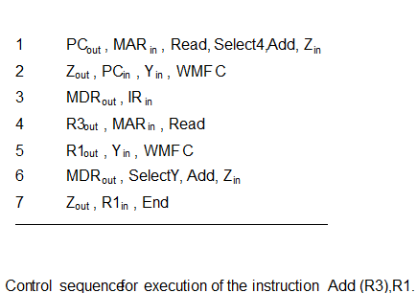
Execution of a Complete Instruction
Add (R3), R1

Slide 11
Execution of Branch Instructions
A branch instruction replaces the contents of PC with the branch target address, which is usually obtained by adding an offset X given in the branch instruction.
The offset X is usually the difference between the branch target address and the address immediately following the branch instruction.
Conditional branch

Slide 12
Execution of Branch Instructions
Step
Action
1
PC
out
,
MAR
in
,
Read,
Select4,
Add,
Z
in
2
Z
out
,
PC
in
,
Y
in
,
WMF
C
3
MDR
out
,
IR
in
4
Offset-field-of-IR
out
,
Add,
Z
in
5
Z
out
,
PC
in
,
End
Figure Control sequence for an unconditional branch instruction.

Slide 13
Multiple-Bus Organization
Bus A
Bus B
Bus C
Incrementer
PC
Re
gister
file
Constant 4
MUX
A
ALU
R
B
Instruction
decoder
IR
MDR
MAR
Memory b
us
Address
Fig:refer from Carl Hamacher page 424
data lines
lines
Fig:Three Bus Organization of the datapath.

Slide 14
Multiple-Bus Organization
Add R1, R2, R3
Step
Action
1
PC
out
,
R=B,
MAR
in
,
Read,
IncPC
2
WMF
C
3
MDR
outB
,
R=B,
IR
in
4
R1
outA
,
R2
outB
,
SelectA,
Add,
R3
in
,
End
Figure:Control sequence for the instruction. Add R1,R2,R3,
for the three-bus organization

